Slide 1
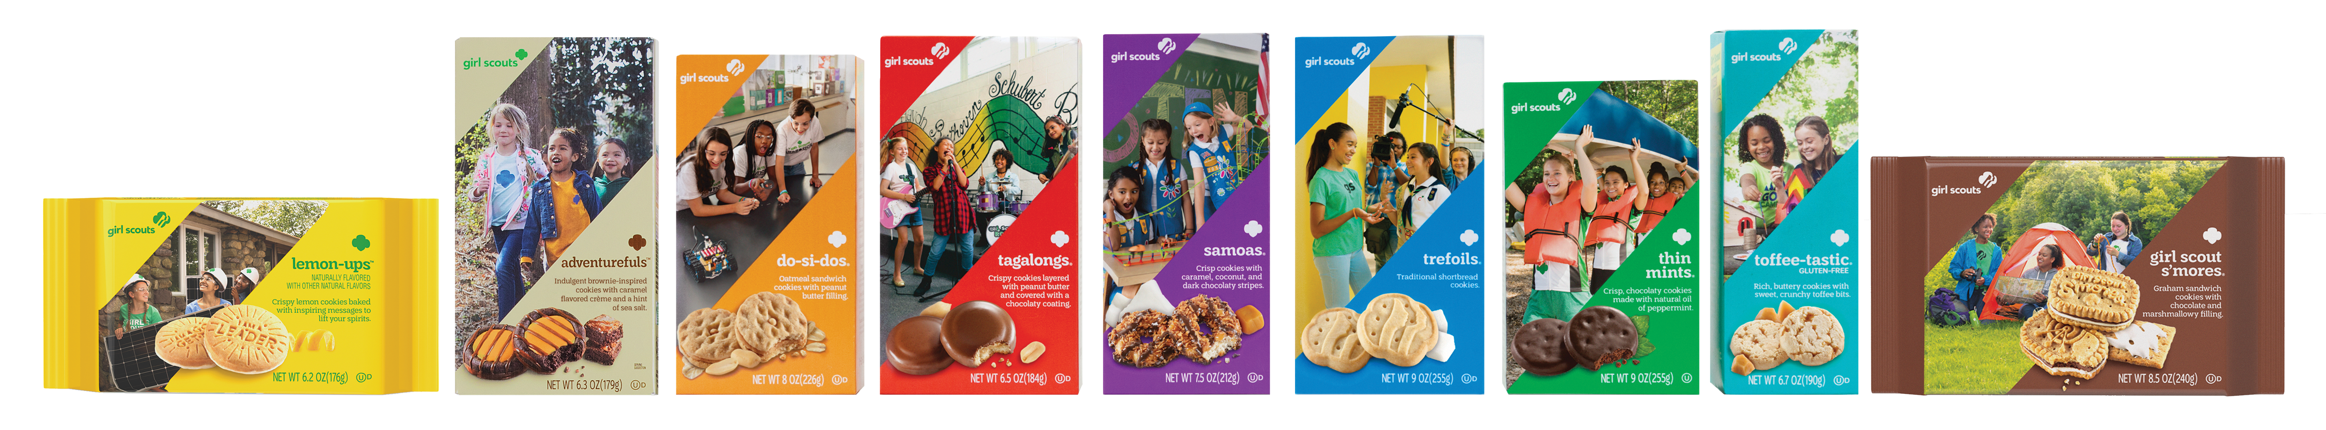
One Smart Cookie
Girl Scout Digital Cookie Sales Trends
Christy Carter Cathy Potter Stacey Booysen

Slide 2

Cookie Filling
Introduction
Database
Machine Learning
Summary Graphs
Interactive Map
Conclusion

Slide 3

Cookie Mom of 9 Years
Focus on Covid impacts to Digital Cookie app usage
Digital Cookie allows credit card transactions
2020 was best sales year ever, and before quarantine
2021 was full covid impact with higher no-contact sales methods
2022 was almost back to normal but with cookie shortage due to supply chain

Slide 4
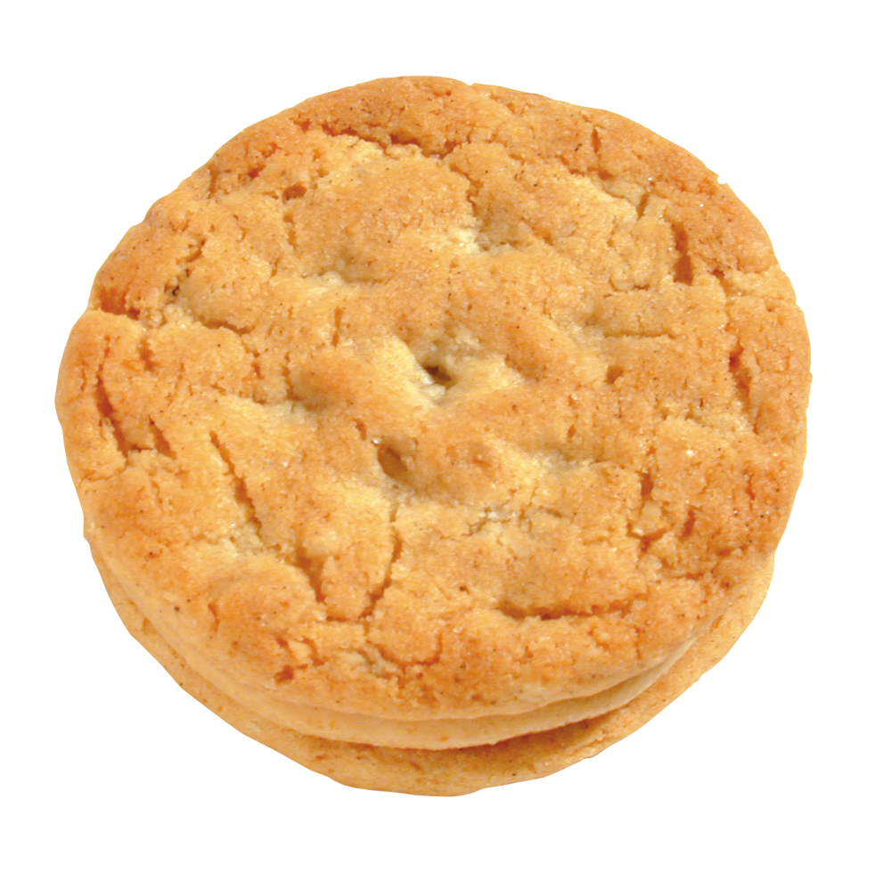
A Batch Made in Heaven
Council Provided:
Digital Cookie sales detail for 2019-2022
Service unit zip code assignments
Extracted from the web:
Median Incomes for specific zip codes from 2020 census data
geoJSON polygons for specific zip codes
Created:
geoJSON with zip code center lat/long

Slide 5
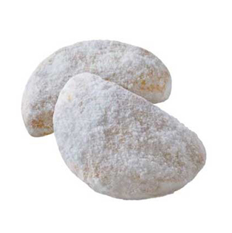
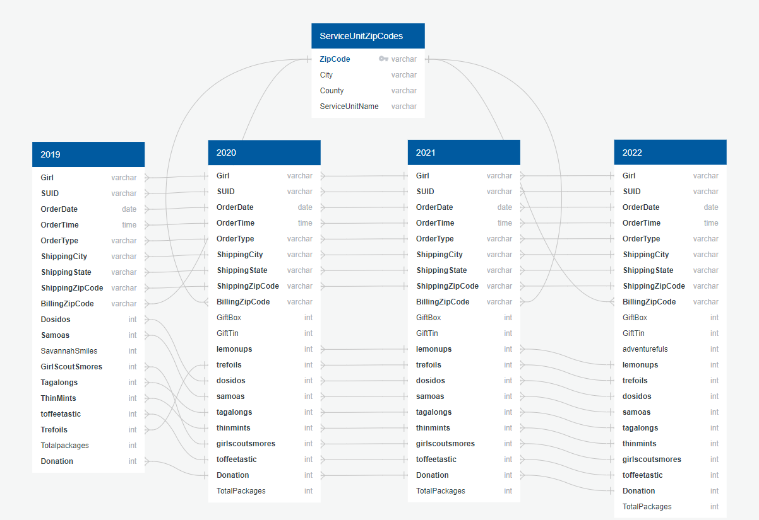
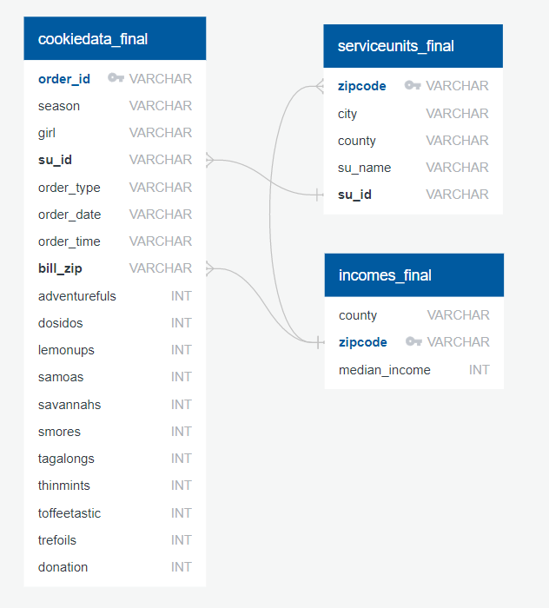
PostgreSQL

Slide 6
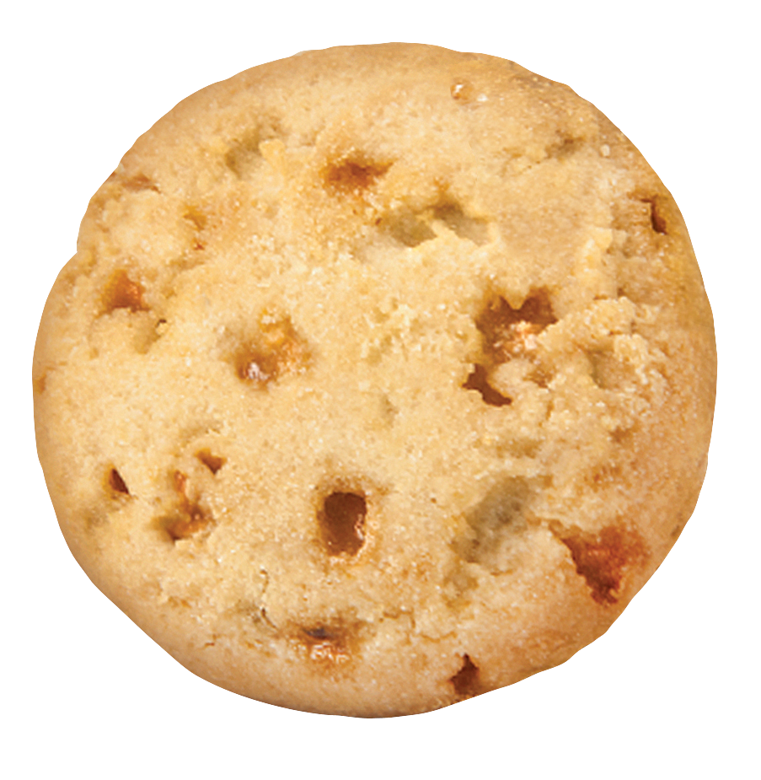
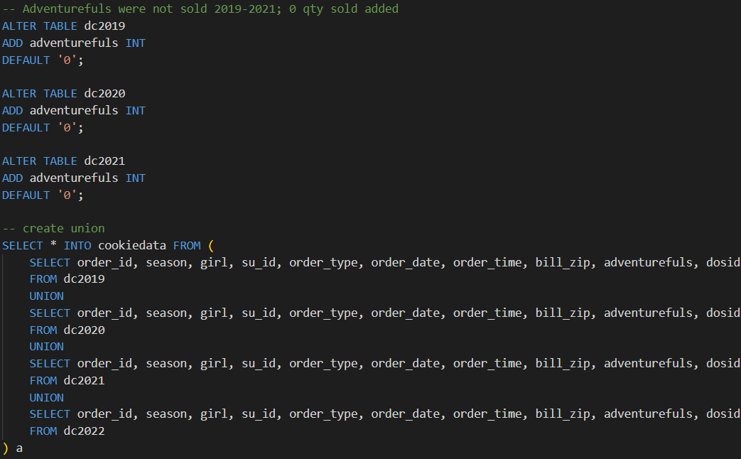
Union (rather than Join)

Slide 7

How the Cookie Crumbles ~Research Questions~
Does median income predict individual digital cookie sales?
Linear Regression Model
Do sales of cookie types based on single digital transactions predict low or high income areas?
Logistic Regression Model

Slide 8
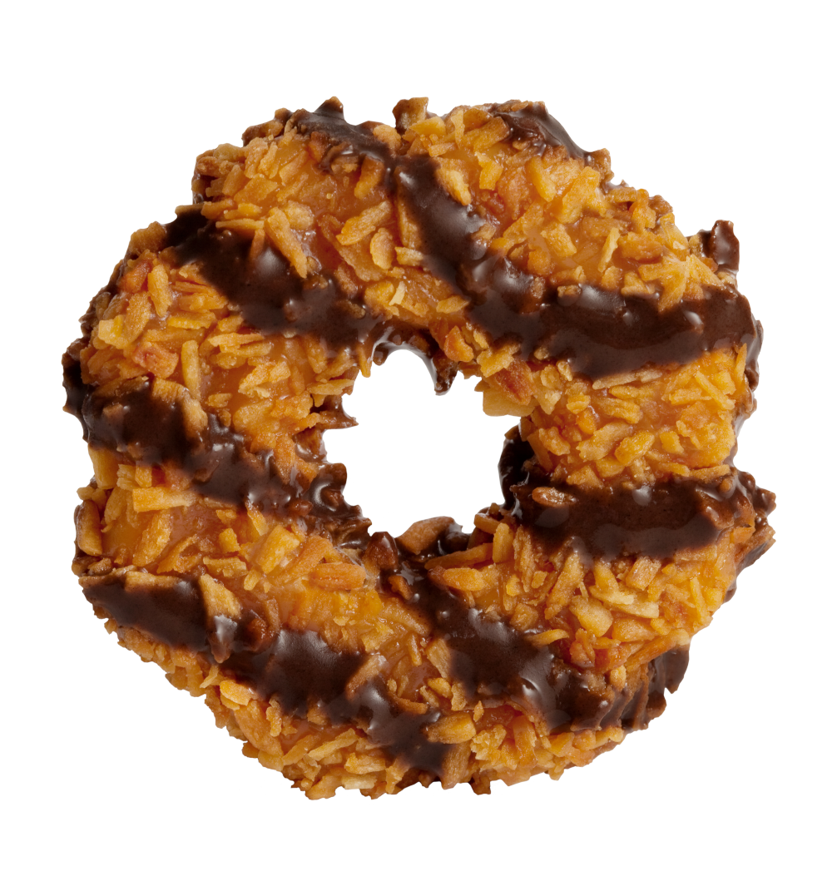
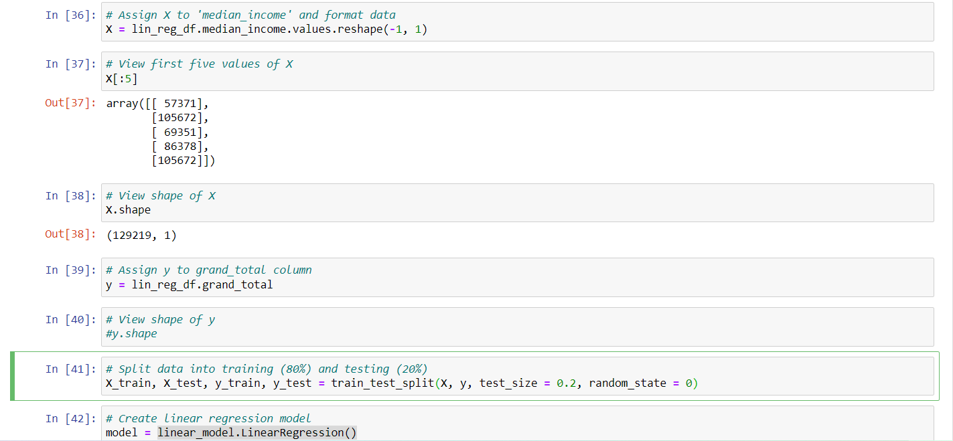
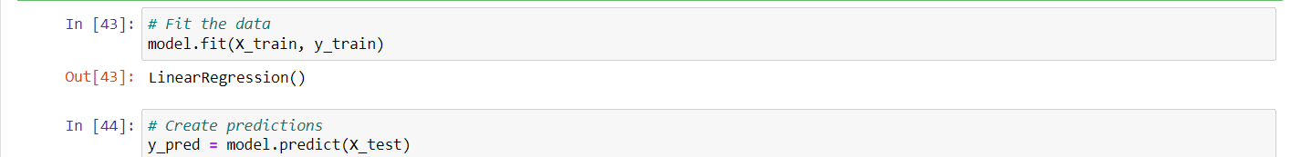
Linear Regression Model
X = median_income
y = grand_total
sklearn train-test-split (80%, 20%)
Raw data
Scaled data
sklearn LinearRegression()
Calculations
R-squared
Model coefficient/intercept
Mean squared error

Slide 9
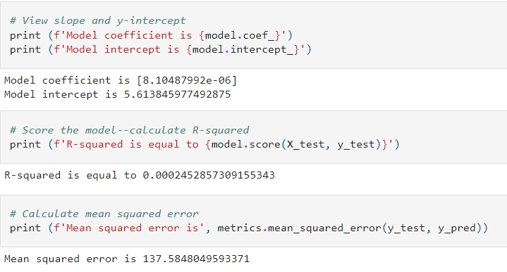
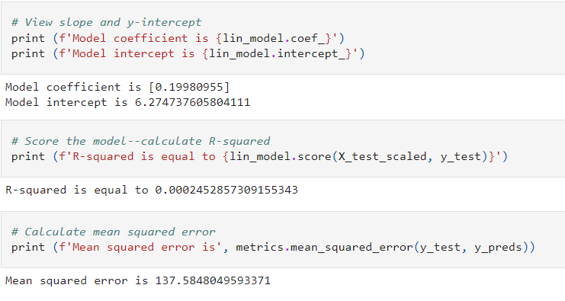
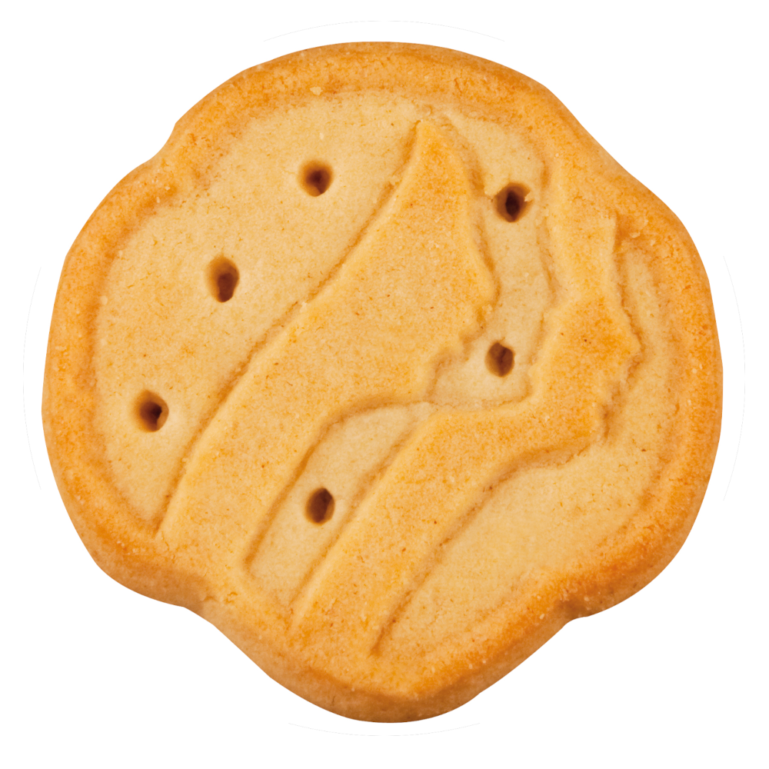
Linear Regression Results
Raw Data:
Scaled Data:

Slide 10
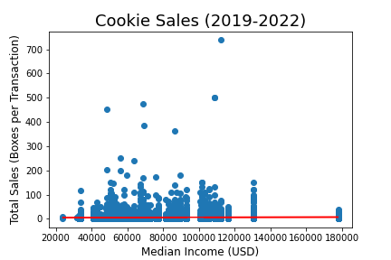
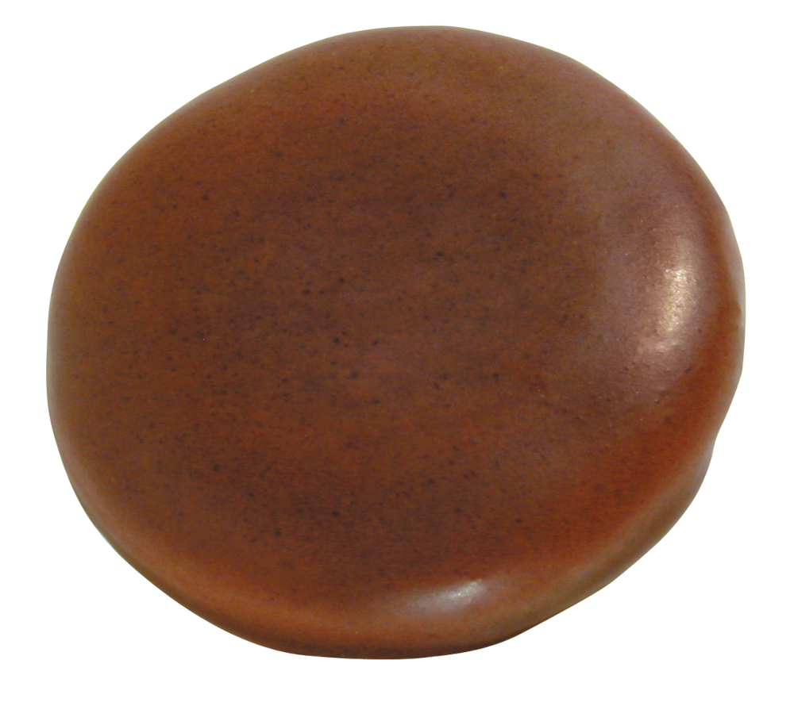
Linear Regression Conclusions
The model is not a good predictor of boxes sold per digital transaction based on median income.
Individuals are just as likely to buy the same number of boxes in any income area.
The high MSE can be attributed to high variation and outliers in sales data.
y = 8.1e-06x + 5.61

Slide 11
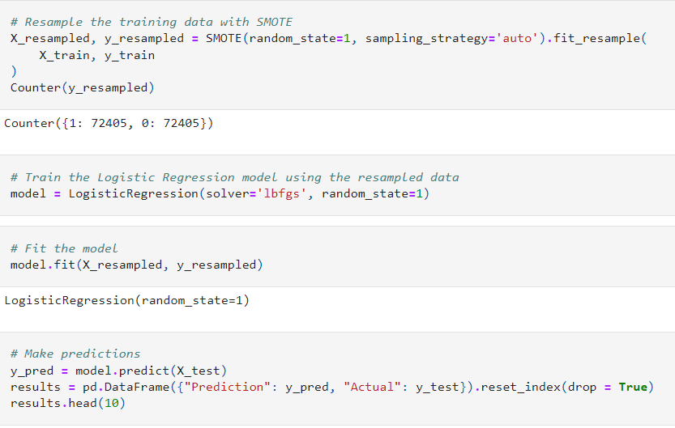
Logistic Regression Model
X = all cookie columns in df
y = high_low_income
sklearn train-test-split (80%, 20%)
Raw data
Scaled data
SMOTEENN
SMOTE
sklearn LogisticRegression()
Calculations
Accuracy/Balanced accuracy score
Confusion matrix
Classification report/Imbalanced classification report

Slide 12

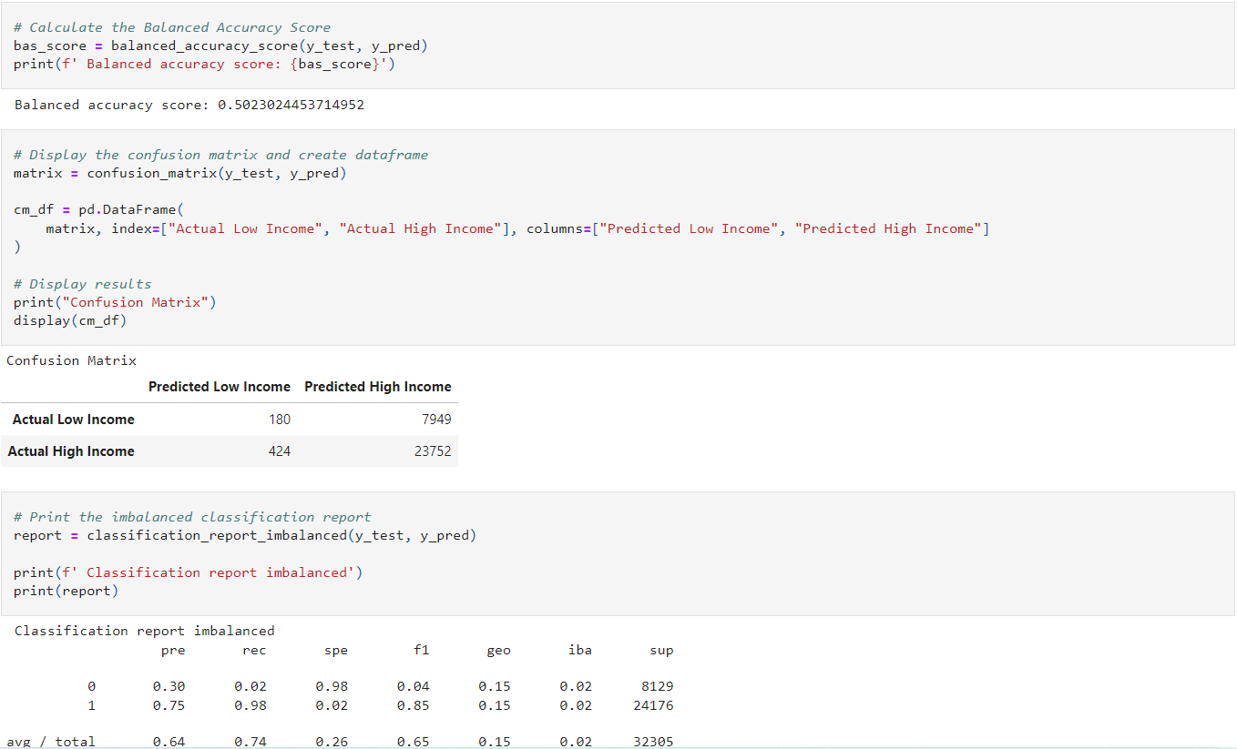
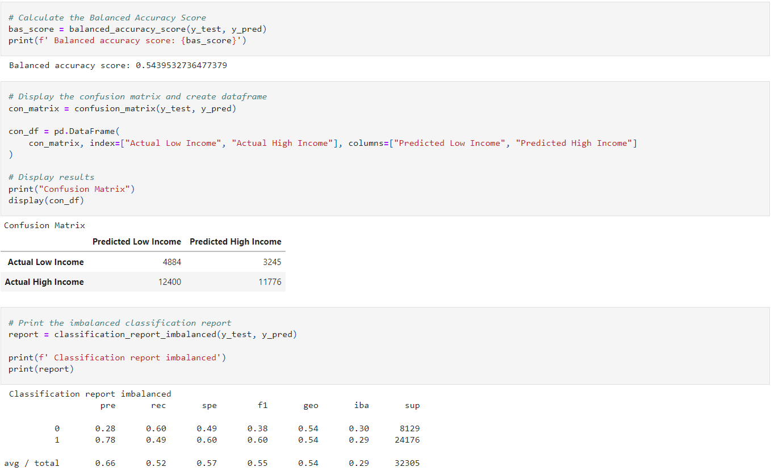
Logistic Regression Results
SMOTEENN:
SMOTE:

Slide 13
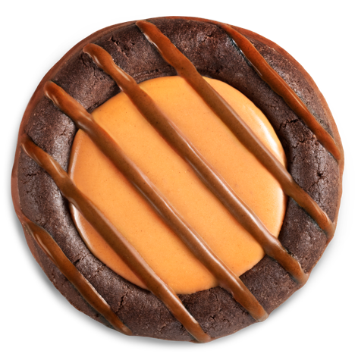
Logistic Regression Conclusions
The model is not a good predictor of high or low income areas when using digital sale transactions.
Recall improved for predicting low income areas but decreased for high income areas with SMOTE.

Slide 14
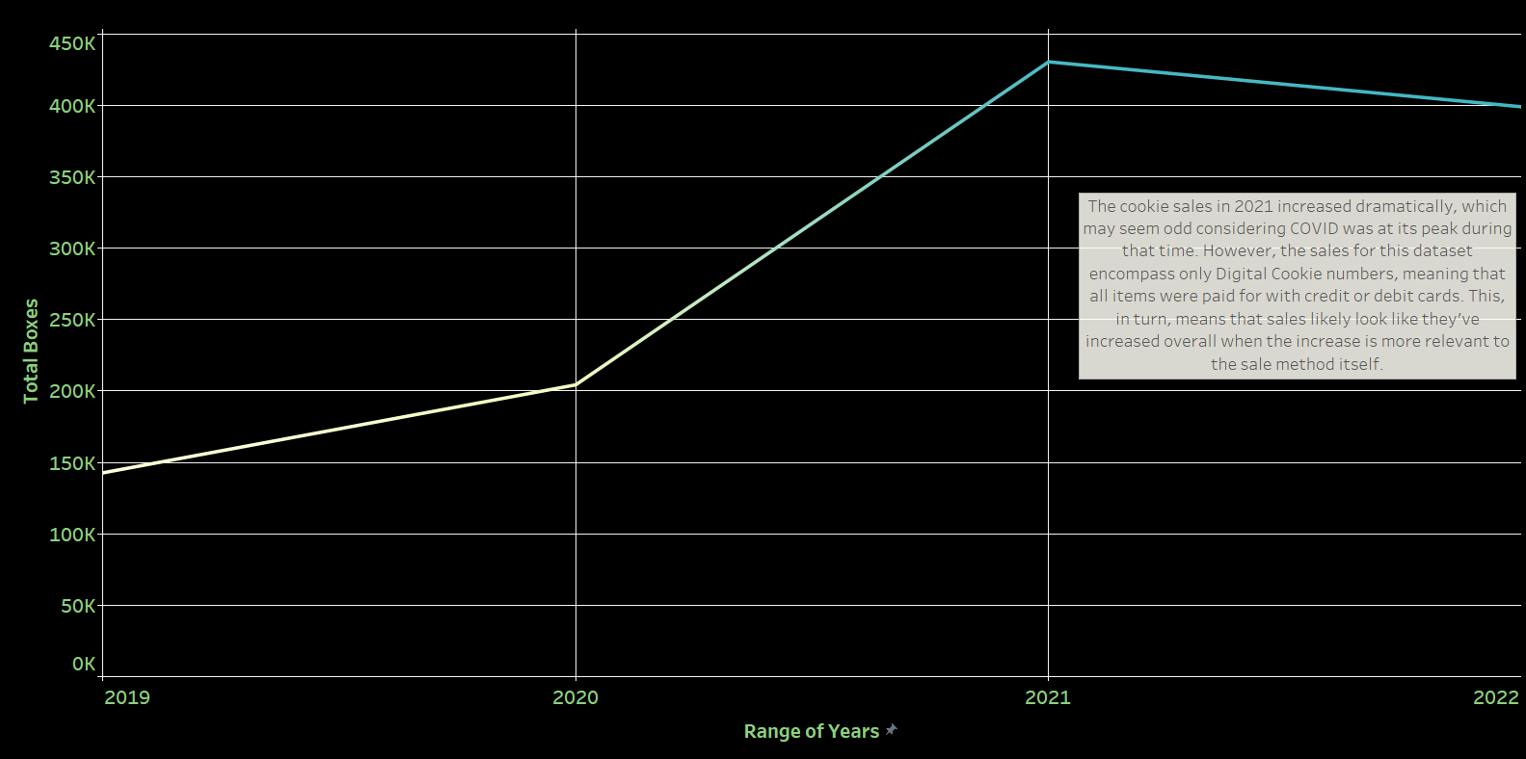
Boxes Sold Over the Past Four Years
Story

Slide 15
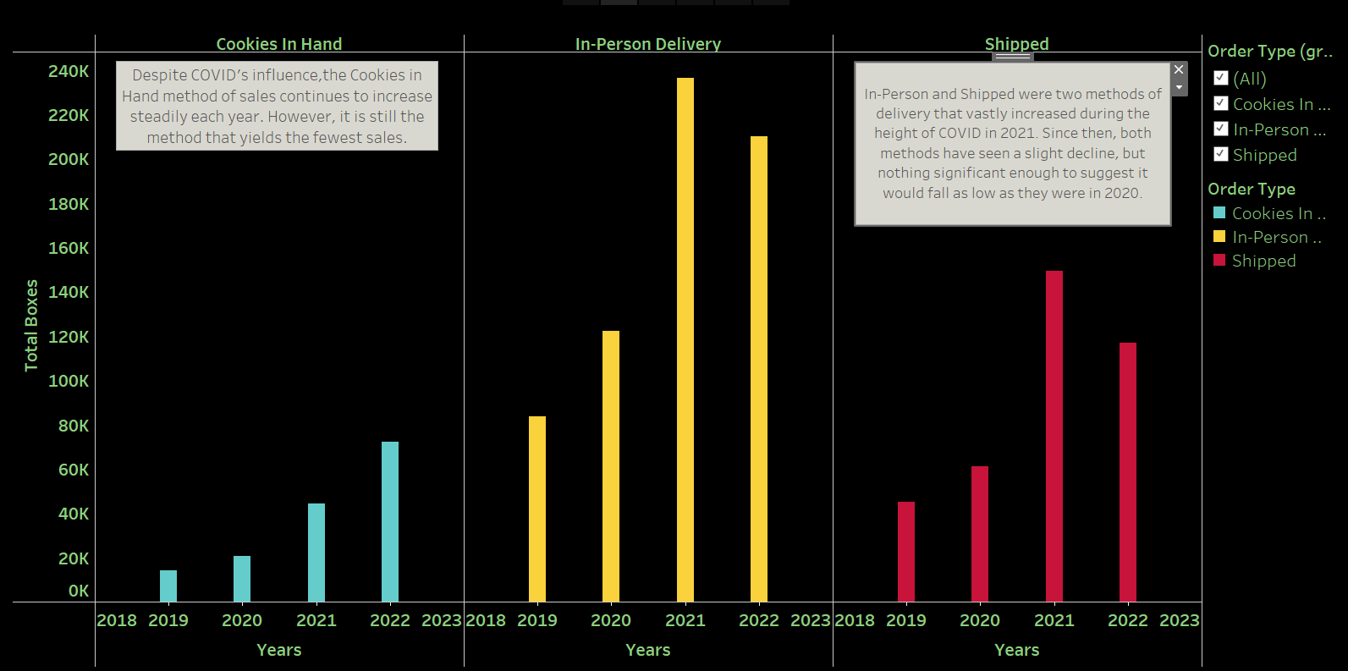
Delivery Method
Story

Slide 16
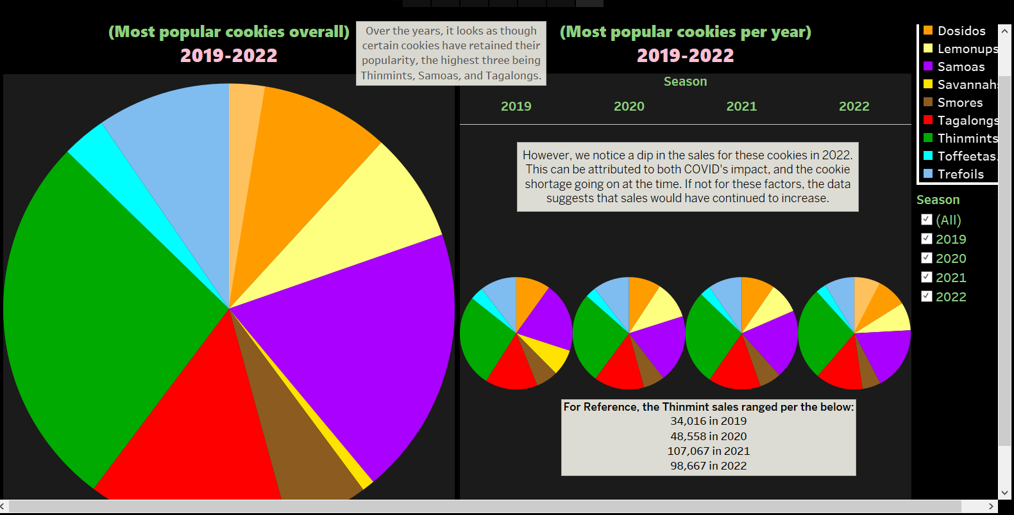
Best of the Batch
Story

Slide 17
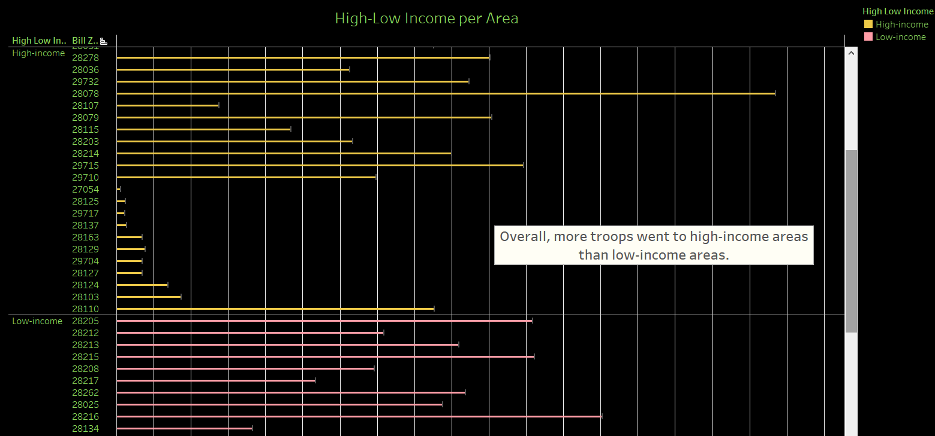
Troops per Zip Code
Story

Slide 18
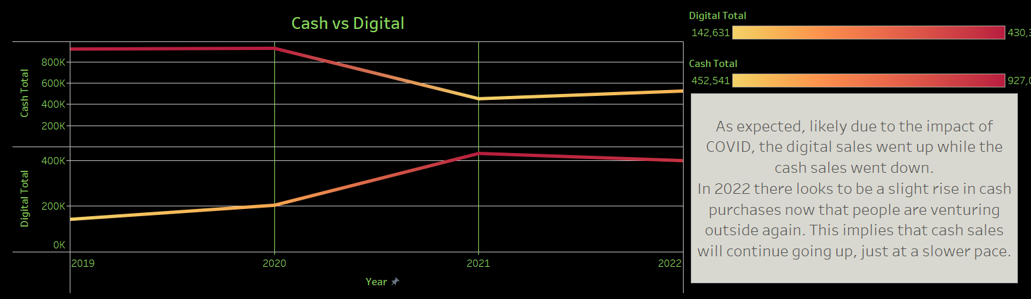
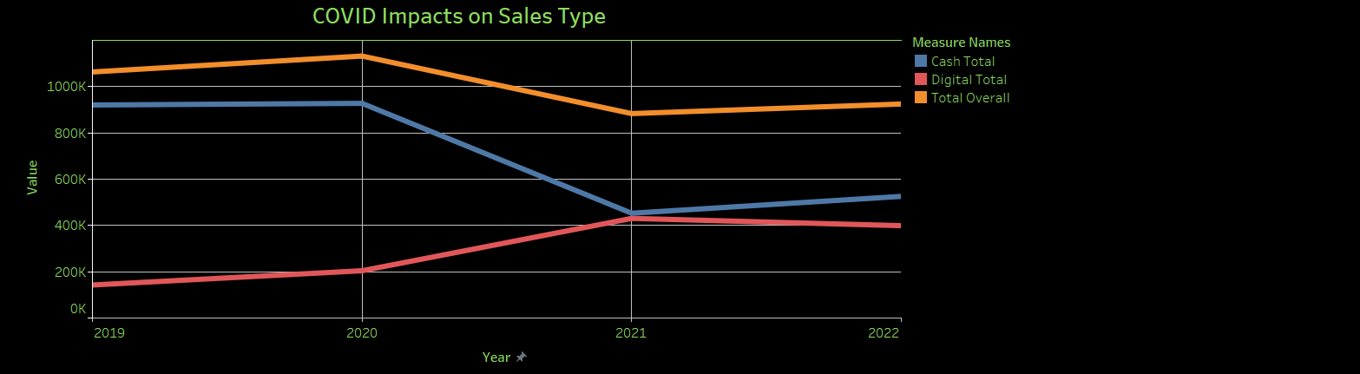
Story

Slide 19
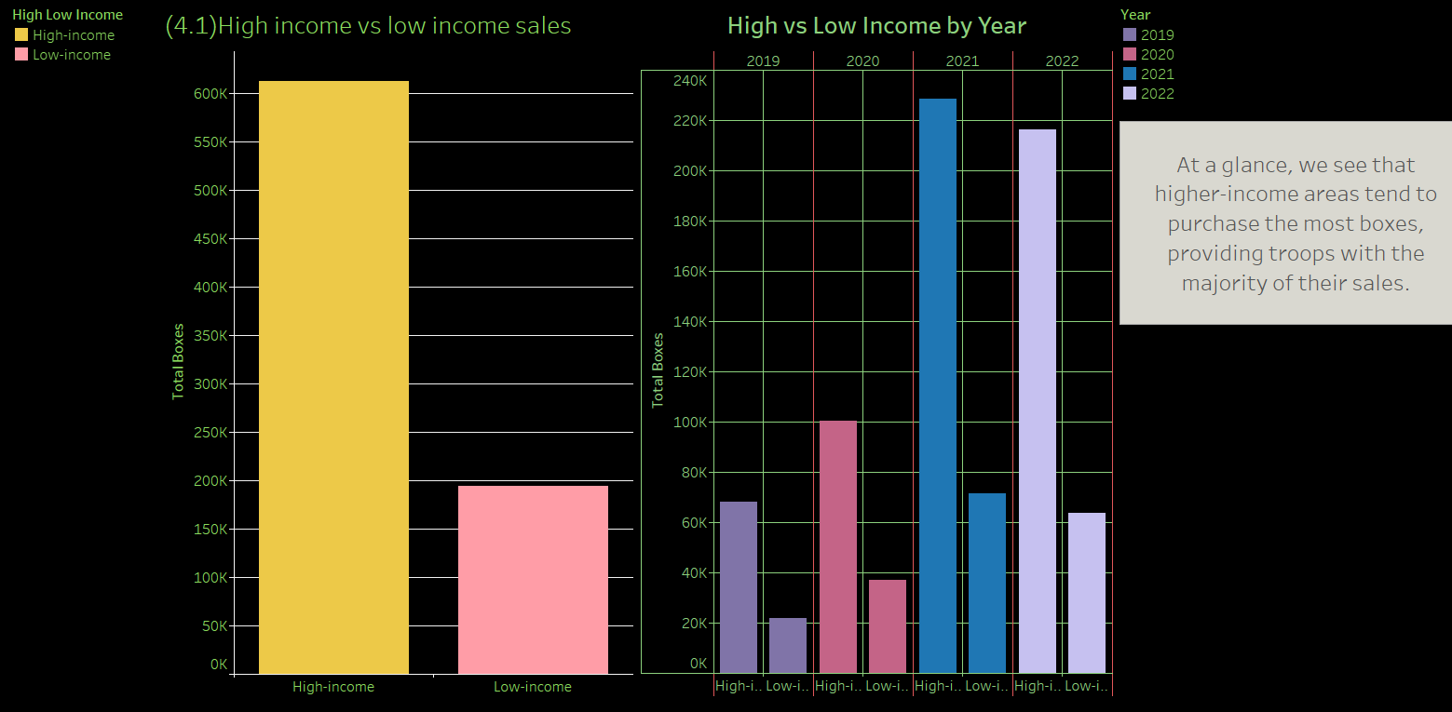
Boxes per High and Low Income Areas
Story

Slide 20
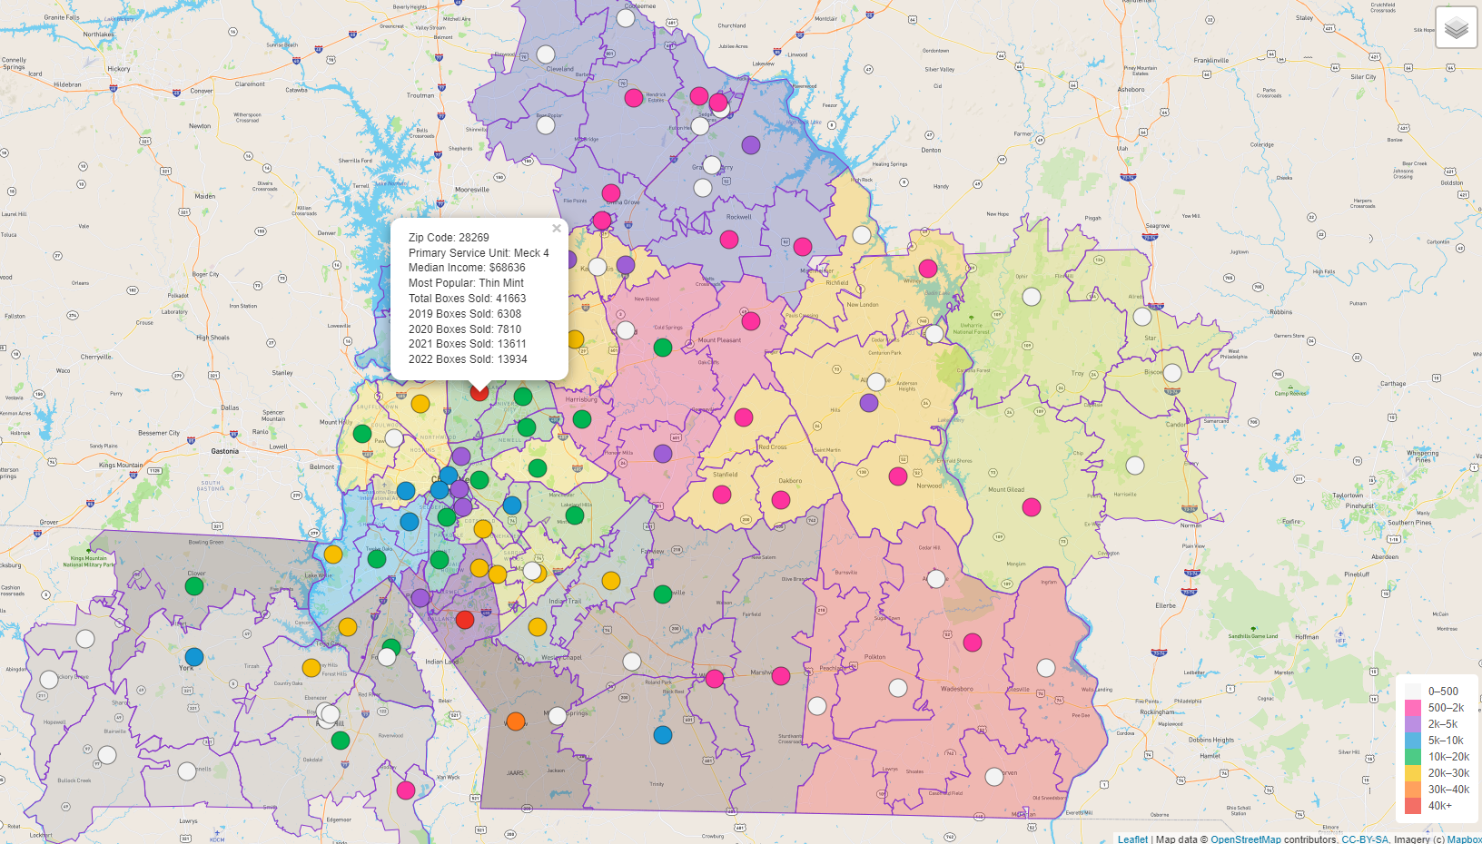

Slide 21
You Gotta Risk it for the Biscuit Closing Remarks
Machine Learning Models were not useful for this type of dataset.
As expected COVID did impact sales but did increase app usage.
The data showed that more boxes were purchased in high-income areas, however, it was found that more troops sold in those areas to begin with.
Thin Mints are the undisputed champion.
The map showed the areas with the highest digital sales, with zip code 28269 coming out as the top area for number of boxes sold.

